Slide 1


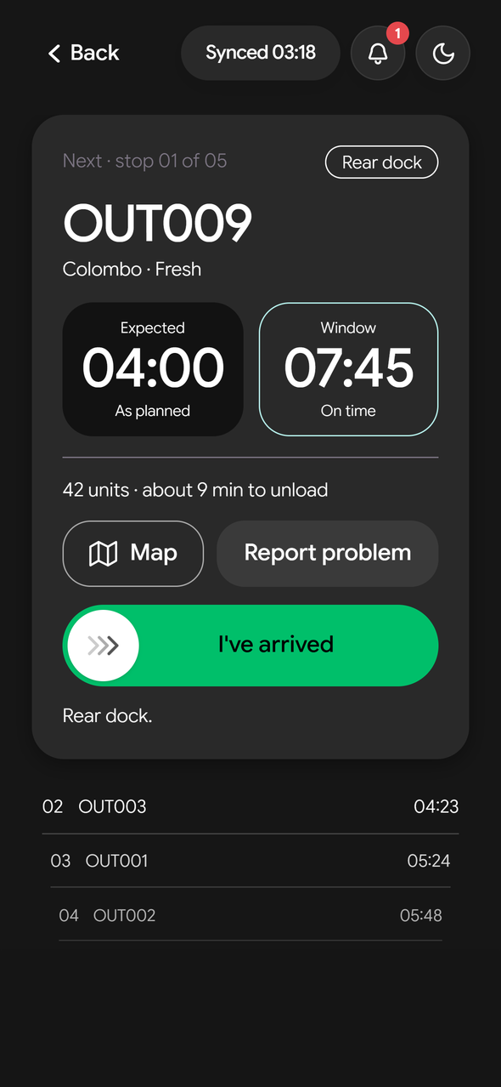

PELIYAGODA DEPOT · 3:30 AM
Waypoint GO
Ground Operations, made intelligent
Team Xception · Tech-Triathlon 2026 Grand Finale
Notes:
Speaker 1 (product) · about 39 s
On screen: Opens on the night scene: 'Peliyagoda depot · 3:30 AM' and the driver's phone opening tonight's run. Click: 'Ground Operations' appears, the other letters fall away, G and O join into 'GO', GO grows into 'Waypoint GO', the truck drives in and the tagline settles.
Three-thirty in the morning at the Peliyagoda depot. Eighty-five orders are waiting. Five of the depot's nine refrigerated vehicles are in the workshop. And every Fresh store must be stocked before eight. (pause) Today, one dispatcher solves this with a spreadsheet, a phone and memory. (pause) We are Team Xception, and we call this work [CLICK] Ground Operations: everything between the order and the shelf. (pause) G-O. (pause) This is Waypoint GO.

Slide 2
The problem
Every morning,
120 stores depend on
one spreadsheet
HOW A DELIVERY RUNS TODAY
Store manager
phones the order in
Dispatcher
types it into a spreadsheet
Fresh · 80
Style · 25
Tech · 15
Loader
works from a printed list
60 vehicles, only 16 can carry chilled · 2 depots
Driver
paper sheet, unseen on the road
Fresh misses 8 AM
Chilled stock spoils
Disputes rest on memory
Waypoint GO · Team Xception
2
Notes:
Speaker 1 (product) · about 33 s
On screen: 'The problem': the network on the left. Click 1: how a delivery runs today, row by row. Click 2: the three consequences.
Waypoint runs three brands on one fleet: sixty vehicles, two depots, a hundred and twenty stores. [CLICK] Orders arrive by phone and are typed into a spreadsheet. Loaders work from printed lists, drivers from paper, and once a truck leaves, nobody can see it. [CLICK] So Fresh misses its eight o'clock opening, chilled stock spoils, and every dispute rests on memory.

Slide 3
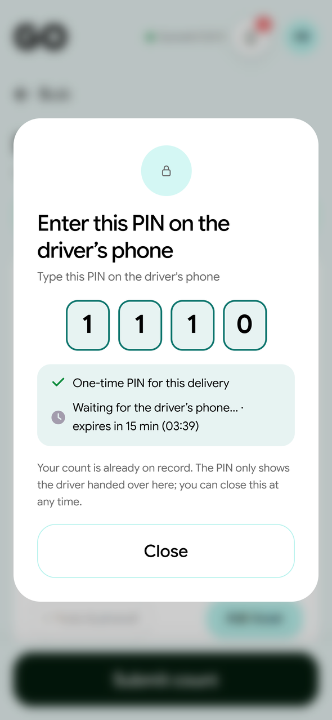
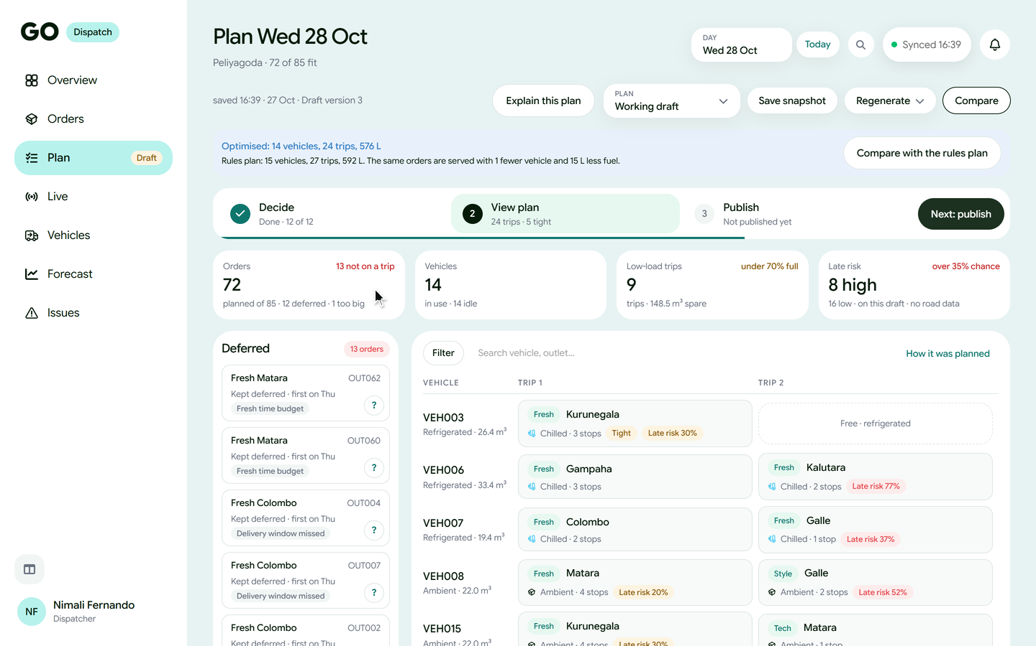
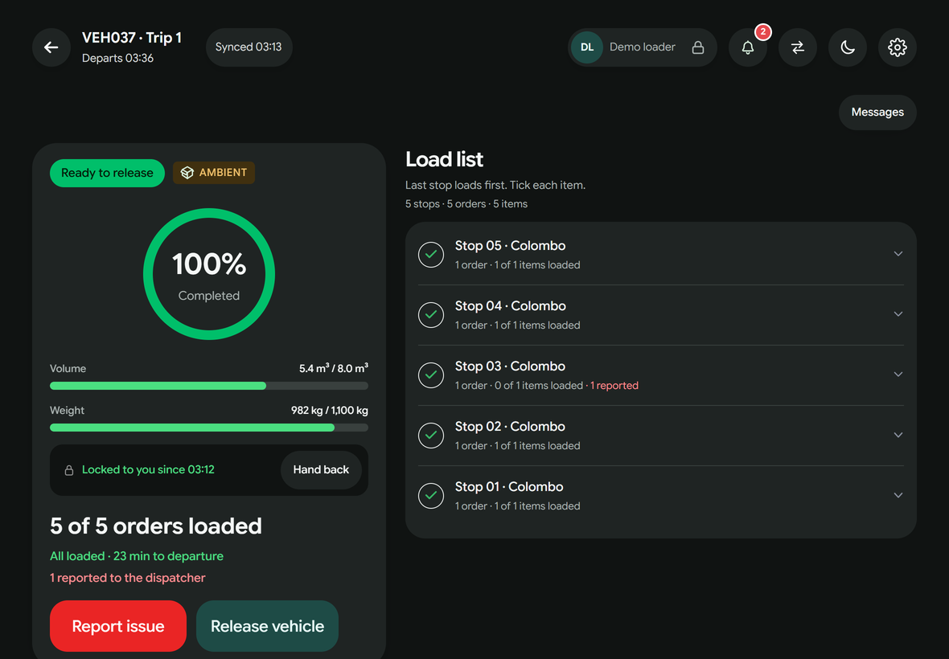
The product
One app for the four people who touch every order
Store manager
Dispatcher
Loader
Driver
orders and receives
plans and watches
loads and checks
delivers, even offline
Waypoint GO · Team Xception
3
Notes:
Speaker 1 (product) · about 21 s
On screen: The four role apps side by side, each screen playing a short live loop: store manager, dispatcher, loader, driver.
Waypoint GO puts the whole delivery day in one app, for the four people who touch every order: the store manager, the dispatcher, the loader and the driver. (pause) One record, from order to receipt. Every handover accounted for.

Slide 4
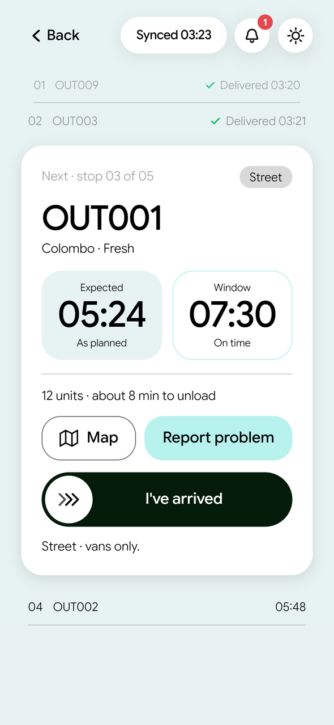
Designathon
Designed for people who start at 3 AM
Why these colours
GO green
The next step to take, in our logo’s green
Teal
Decisions and links: calm and trusted
Night
Dark screens for 3 AM: no glare in the cab
Amber
Needs attention: tight or at risk
Red
Late or failed, always with words
Purple
Forecasts and what-ifs: the future
One action per screen
Slide to confirm
Sinhala · Tamil · English
Day
Night
Waypoint GO · Team Xception
4
Notes:
Speaker 1 (product) · about 34 s
On screen: Day and night driver screens doing the same steps together, and what each colour means.
In the Designathon, we designed it for people who start work at three in the morning. Night mode, so drivers and loaders are not dazzled. One action per screen, and slide to confirm, so nothing is tapped by accident. Colour only where it means something: green for the next step, amber for attention, red for late, always with words. And it speaks Sinhala, Tamil and English.

Slide 5
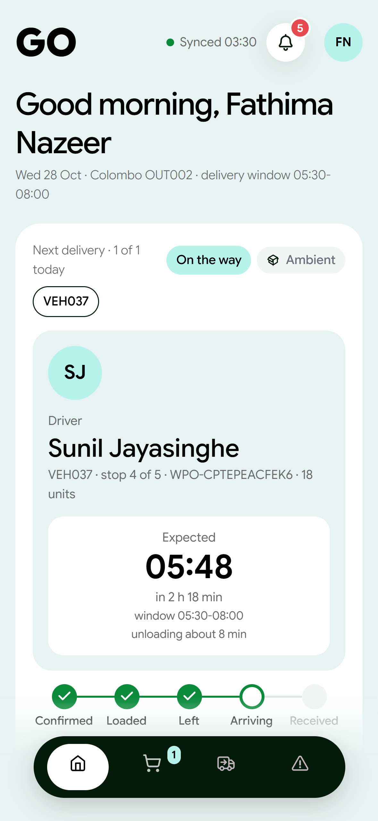
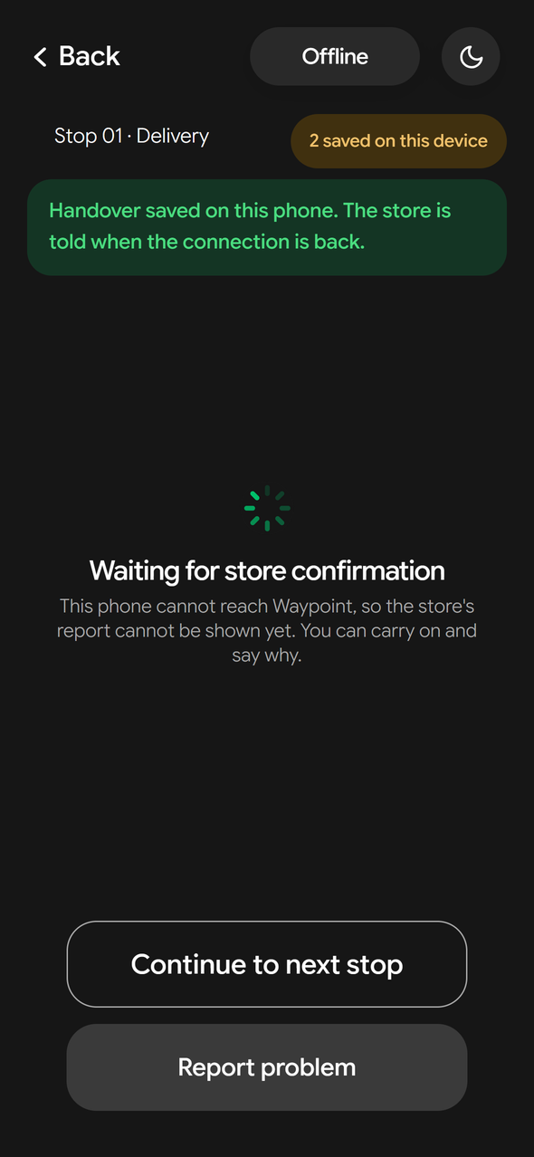
Hackathon · live at waypointgo.live
One delivery day on one record
waypointgo.live
DELIVERY RECORD
Delivery day Wed 28 Oct · VEH037
4:00 PM
DISPATCHER
Plan ready in seconds; every waiting order explained
3:13 AM
LOADER
Last stop loaded first; damage flagged before departure
4:00 AM
DRIVER
Next stop on the phone; handover saved offline
5:48 AM
STORE MANAGER
Received and confirmed with a one-time PIN
Waypoint GO · Team Xception
5
Notes:
Speaker 1 (product) · about 73 s
On screen: Clicks 1–4 open Plan, Load, Deliver and Receive; each screen plays by itself, and the delivery record on the right gains a line each time.
In the Hackathon, we built it, and it is live. Here is one delivery day. [CLICK] Four p.m.: orders close, and the dispatcher presses Generate. In seconds, GO places every order it can, within weight, volume, refrigeration and delivery windows. Every order that has to wait shows the rule that stopped it. [optional: It even found a plan with one vehicle fewer.] [CLICK] Three a.m.: the loader packs the last stop first, and a damaged carton is flagged before the truck leaves. [CLICK] On the road, the driver sees the next stop and the unloading time. With no signal, the handover is saved on the phone and sent when coverage returns. [CLICK] And the store knows the truck arrives at five forty-eight, and confirms with a one-time PIN. (pause) That is the product. [Speaker 2's name] will show you how it thinks.

Slide 6
Datathon
Three kinds of intelligence under one rule
Predict
Foresee
Decide
Which stops will be late, and how long unloading takes
Demand ten weeks ahead, as trucks, refrigerated trucks and drivers
The best plan when trucks run short, and why
Task 1
Task 2A
Task 2B + live planner
Rules first
Our own models
Language AI, wording only
A person decides
If a model is ever down, GO falls back to a safe estimate and says so on screen.
Waypoint GO · Team Xception
6
Notes:
Speaker 2 (intelligence and business) · about 44 s
On screen: Three intelligence cards. Click 1: the rule, from rules to a person deciding, and the fallback line.
Thank you. In the Datathon, we built GO's intelligence, and it now runs inside the app. It does three things: it predicts which deliveries will be late, it forecasts demand ten weeks ahead, and it decides the best plan when trucks run short, and explains why. [CLICK] One rule runs through all of it: rules first, then our own models, a language model only for wording, and a person always decides. If a model is ever down, GO falls back to a safe estimate and says so.

Slide 7
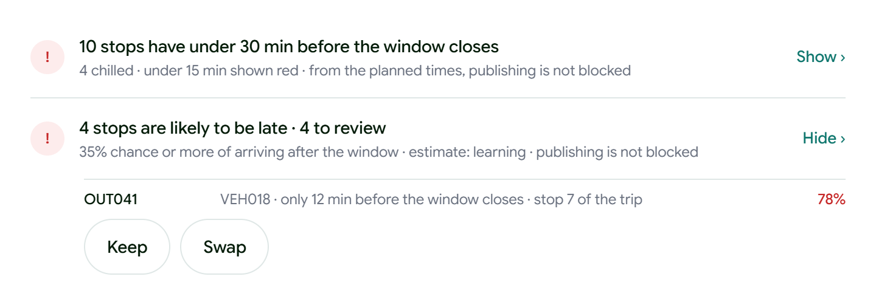
Datathon · Task 1
Late deliveries flagged before the truck leaves
How: every planned route is replayed hundreds of times, stop by stop, beside a machine-learning model that sees only planning-time facts.
7 in 10
late deliveries flagged before the truck left
−74%
false alarms compared with a simple statistical method
In the app: each risky stop shows its chance and reason, to keep or swap
Six unseen weeks, Jan–Feb 2026: 488 of 678 late flagged
95 vs 368 false alarms · AUC 0.976
Waypoint GO · Team Xception
7
Notes:
Speaker 2 (intelligence and business) · about 47 s
On screen: Click 1: the two results. Click 2: the risk review panel from the app.
First, prediction. We replay every planned route hundreds of times, stop by stop, alongside a machine-learning model. [CLICK] On six weeks it had never seen, it flagged seven in ten late deliveries before the truck left. And it raised seventy-four per cent fewer false alarms than a simple method. [optional: On average, its unloading-time estimate is within four minutes.] [CLICK] Before publishing, the dispatcher sees each risky stop and why, and keeps or swaps it. So the problem is caught at four in the afternoon, not at nine the next morning.

Slide 8
Datathon · Task 2A
Demand seen ten weeks ahead
3%
Weekly volume, both depots, m³
FORECAST
New Year rush +38%
forecast error, against 8% for
‘same week last year’
In the app, every forecast week becomes the trucks, refrigerated trucks and drivers to book.
Holiday week −34%
Waypoint GO · Team Xception
8
Notes:
Speaker 2 (intelligence and business) · about 46 s
On screen: Weekly demand since January 2025 and the 10-week forecast. Click 1: the error. Click 2: the New Year peak, the holiday dip and what the app turns them into.
Second, demand. The forecast builds each week from the bottom up: which stores will order, on which days, and how much. It learns paydays, the monsoon and festivals. [CLICK] In testing it was off by about three per cent; the usual 'same week last year' method is off by eight. [CLICK] It sees the Sinhala and Tamil New Year rush, almost forty per cent above a normal week, and turns it into the trucks, refrigerated trucks and drivers to book in advance. Paydays and festivals stop being surprises.

Slide 9
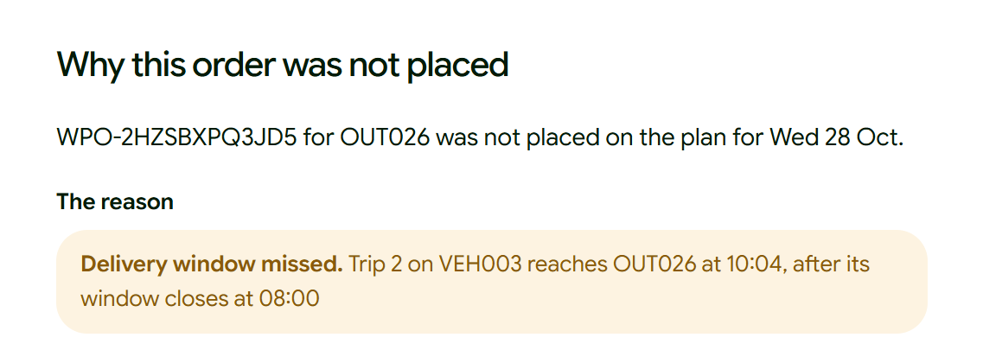
Datathon · Task 2B · now in the live planner
Too few trucks? GO finds the best plan and says why
77
of 85 orders served
On the peak day, 79 is the proven maximum.
Two wait by choice, so no store is skipped two days running.
The real limit: refrigerated space
In the app: every waiting order shows the rule that stopped it
Chilled demand
181.6 m³
What if one refrigerated truck comes back?
Refrigerated capacity
172.4 m³
+9 orders
+48% chilled
81 instead of 72 in the live app
161 m³ instead of 109 m³
1,911 of 1,956 orders that slipped a day were Peliyagoda chilled
The live app also enforces every store’s delivery window and fuel quota (Datathon plan: 77 of 85).
Waypoint GO · Team Xception
9
Notes:
Speaker 2 (intelligence and business) · about 50 s
On screen: 77 of 85; 79 is the most possible. Click 1: refrigerated space is the bottleneck. Click 2: the app's explanation, then the what-if.
Third, decisions. On the competition's peak day, eighty-five orders were waiting, and an exact optimiser proved that at most seventy-nine could go. Ours serves seventy-seven. The other two wait by choice, so no store is skipped two days running. [CLICK] The real limit is refrigerated space. [optional: In two years of history, nearly every delayed order was a Peliyagoda chilled order.] [CLICK] So in the app, every waiting order shows why, and the dispatcher can ask: what if one refrigerated truck comes back from the workshop? Nine more orders, and almost fifty per cent more chilled goods.

Slide 10
Impact
What changes for Waypoint
spreadsheet and memory
LKR 26.5m
Dispatcher
One explained plan, every stop on record
printed list that goes stale
expected value a year
Loader
Live load list, damage flagged early
LKR 8–12m
paper and phone calls
Driver
Next stop on the phone, works offline
to build, then about LKR 19,000 a month to run
calls to ask where it is
Store manager
Arrival time, PIN receipt, photo reports
About 5 months
festival capacity guessed
to pay back after rollout
Management
Fleet needs known 10 weeks ahead
Team estimates from public data; the pilot measures each one.
Waypoint GO · Team Xception
10
Notes:
Speaker 2 (intelligence and business) · about 44 s
On screen: Before and after for each role. Click 1: value, cost to build and run, payback.
What changes for Waypoint? One explained plan instead of a spreadsheet. Problems caught before departure, not at the store. Proof for every delivery. And capacity known weeks ahead. [CLICK] We estimate the value at about twenty-six and a half million rupees a year, mostly from fuel and from Fresh on the shelf by eight. It costs about eight to twelve million rupees to build, and about nineteen thousand rupees a month to run. [optional: Payback is about five months.] These are estimates; the pilot will measure each one.

Slide 11
Our ask
An 8-week pilot at the Kandy hub
Kandy first: 45 of the 120 stores, so the risk is contained, and mobile signal drops on the Kandy corridor, so offline is tested where it matters.
1
Weeks 1–4 · Shadow
2
Weeks 5–8 · Live
3
Week 9 · Go/no-go
Then Peliyagoda
beside today’s process
the whole day runs in GO
judged on four numbers
+5 pts
−30%
−20%
90%+
Fresh before 8 AM
dispatcher calls per trip
damaged-goods write-offs
stops recorded in the app
Waypoint GO · Ground Operations, made intelligent
Waypoint GO · Team Xception
11
Notes:
Speaker 2 (intelligence and business) · about 38 s
On screen: Pilot steps and why Kandy. Click 1: the four success numbers. Click 2: the closing line.
So our ask: an eight-week pilot at the Kandy hub, four weeks in shadow, then four weeks live. [CLICK] We will judge it on four numbers. Fresh before eight: up five points. Dispatcher calls: down thirty per cent. Write-offs: down twenty per cent. And at least nine in ten stops recorded in the app. If we hit them, Peliyagoda follows. [CLICK] Waypoint GO: Ground Operations, made intelligent. (pause) Thank you.

Slide 12

Thank you
Ground Operations, made intelligent
waypointgo.live · questions welcome
7 in 10
LKR 26.5m
8 weeks
late deliveries flagged early
expected value a year (estimate)
pilot at the Kandy hub
Notes:
(Stays on screen during questions. Both speakers answer; use the backup slides after this one.)

Slide 13
Backup
Answers at a glance
14
How GO is built
21
Business case
15
The planning engine
22
Rollout plan and risks
16
Task 1 · Late risk and unloading time
23
Beyond Waypoint: market and revenue
17
Task 2A · Demand forecast
24
From design to product, and our honest limits
18
Task 2B · The peak-day plan
25
Engineering quality
19
Trust, safety and privacy
26
Numbers at a glance
20
Works offline, fails gracefully
Waypoint GO · Team Xception
13
Notes:
Backup index. Click a row, or type its number and press Enter, to jump to it. Each backup has an Index button to come back.

Slide 14
Backup
Index
How GO is built
One web app for every role, a modular backend, and the models served beside it
People
Web app (Next.js PWA)
Backend (Spring Boot)
Data and models
Store manager · desktop or phone
Four role workspaces
14 modules, from ordering to intelligence
PostgreSQL 16 · row-level security · 188 migrations
Dispatcher · desktop
Offline queue, replayed exactly once
One command path: permission check + audit
Model service (FastAPI): late risk + demand
Loader · shared tablet, PIN
Service worker and caches
Events and a live change stream
Checksums and file scan; fallback estimate if down
Driver · phone, offline
Sinhala, Tamil, English
Language AI gateway: off by default, masked, capped
AI assistants · Claude, ChatGPT via MCP
Runs on one server (≈ LKR 19,000 a month) with Docker Compose · Prometheus, Grafana, Loki and alerts · tests on every pull request
Waypoint GO · Team Xception
14
Notes:
Architecture. One responsive web app (PWA) for all roles; Spring Boot modular monolith; PostgreSQL with row-level security; FastAPI model service with checksums and a fallback; optional language-model gateway; MCP for AI assistants; one VPS, Docker Compose.

Slide 15
Backup
Index
The planning engine
Every order checked against every rule; people make the final call, with a reason
Step | What happens
1 · Place | Orders placed in priority order; earlier deferrals first (9 rules)
2 · Re-plan reefers | Refrigerated vehicles planned again as a whole; kept only if better
3 · Optimise | Same orders on fewer vehicles, trips and litres (1 vehicle, 3 trips, 15 L saved)
4 · Decide | Dispatcher places by hand, swaps or keeps deferred, always with a reason
5 · Publish | Every rule checked again; loaders, drivers and stores are told
Check | 13 checks per order
Vehicle | available, home depot, refrigerated, van-only
Trip | one brand and district, one temperature
Capacity | weight and volume, no split orders
Time | delivery window, 2 trips a day, Fresh 270 min
Fuel | weekly quota per vehicle
Explanations come from the engine, not guesswork: each waiting order shows the rule that stopped it, what was fine, where it could go, the closest it came and the smallest change. A what-if re-runs the day with one more vehicle without changing the plan.
Why 72 in the app and 77 in the Datathon? The app also enforces every store’s delivery window and fuel quota; the Datathon plan used the booklet’s time budgets, where 3 stops arrived 16 to 87 minutes late.
Waypoint GO · Team Xception
15
Notes:
Why 72 in the app and 77 in the Datathon? The app also enforces each store's delivery window and fuel quota; the Datathon plan used the booklet's time budgets and let 3 stops arrive 16 to 87 minutes late. Both are correct for their rules.

Slide 16
Backup
Index
Task 1 · Late risk and unloading time
Labels built from the route records; a simulator and LightGBM, blended
6 unseen weeks | Statistical | LightGBM | Ensemble | Selected
Unloading error (min) | 5.24 | 3.75 | 3.66 | 3.72
Late log-loss | 0.302 | 0.133 | 0.125 | 0.131
Correct at 0.5 | 85.8% | 94.5% | 94.6% | 94.5%
False alarms | 368 | 115 | 89 | 95
Training time | 0.01 s | 18 s | 16 min | 1.5 min
Per order / size | – | – | 2 s · 33 MB | 48 ms · 9.7 MB
Service time = leave − later of (arrival, window open)
Late = arrival after the window closes
Simulator: hundreds of runs per route, delays carried stop to stop
Blend in log-odds: 50/50 for lateness, 55/45 for minutes
Caught 488 of 678 late; 84% of flags right; AUC 0.976
Why the selected model? Within 0.06 minutes of the best, 10 times faster to train than the ensemble, one library, 48 ms per order. In production it must first beat the built-in estimate on our own deliveries (backtest and trust gates).
AUC 0.976: a late stop ranks riskier than an on-time one 97.6% of the time
No road data at planning time: AUC 0.957 (production figure)
Waypoint GO · Team Xception
16
Notes:
Labels: service time = leave time minus the later of arrival and window open (waiting is not service). Late = arrival after the window closes. Holdout: last 6 weeks in date order. Without road conditions (as at planning time) AUC is 0.957: the honest production figure.

Slide 17
Backup
Index
Task 2A · Demand forecast
Bottom-up: expected orders × expected size, tested on 25 rolling forecasts
WAPE (miss ÷ volume) | Selection | Test | Latest 6 wk
Total volume | 3.03% | 3.18% | 2.99%
Chilled volume | 2.07% | 1.97% | 2.65%
Same week last year | 8.26% | – | –
LightGBM, weekly | 5.98% | – | –
LightGBM, per order | 4.78% | – | –
Count: each store’s ordering days learned from history
Size: four regressions on log volume (Fresh ambient, Fresh chilled, Style, Tech)
Features: store, trend, weekday, payday, monsoon, season, one ramp per festival
Every order counted once, including deferred and 24 recovered never-run orders
Submitted 10 weeks: 18,682 m³ in total, 6,012 m³ chilled.
Peak: week 15, 2,581 m³, before the New Year; low: week 16, 1,230 m³.
In the app: the Forecast screen turns weeks into vehicles, reefers and drivers, and grades each week once it ends.
701 fitted numbers, 13 KB; reproduces the submission exactly
Beat the benchmark in all 25 tests (3.05% vs 3.76%)
Waypoint GO · Team Xception
17
Notes:
WAPE = total absolute error divided by total actual volume. 15 selection starts, 6 test starts, then the latest 6 weeks. Regression chosen: simplest of the statistically tied models (Diebold–Mariano with Holm). Tech is the weak spot (about 30%), but it is 3% of volume.

Slide 18
Backup
Index
Task 2B · The peak-day plan
Exact optimisation (CP-SAT) with a written priority policy
 | Result
Orders served | 77 of 85 (79 is the proven maximum)
Trips and vehicles | 27 trips on 17 vehicles
Chilled delivered | 131.0 of 181.6 m³
Feasibility | All 7 rules pass the organisers’ checker
Late stops (strict clock) | 3 stops, 16–87 min, fewest of the tied plans
# | Priority rules, in order
1 | Serve the 10 orders deferred yesterday
2 | Serve the 3 van-only chilled orders (reefer van)
3 | Most orders served
4 | Most chilled m³ on reefers; then urgency
5 | Fewest trips, then fewest vehicles
6 | Fewest late stops
Limiting resource: 26 chilled orders need 181.6 m³; the 4 available reefers (refrigerated vehicles) carry 172.4 m³ in two trips. Six deferrals were unavoidable; two were the cost of rule 1 (9.76 m³).
Recommendation: release workshop reefers VEH004 and VEH005, and all 26 chilled orders are served; split the 40.7 m³ Style order at entry.
Waypoint GO · Team Xception
18
Notes:
Six deferrals were unavoidable (one order bigger than any vehicle and five chilled orders with no reefer room or time). Two were a choice: serving yesterday's deferred orders first cost 2 orders and 9.76 m³. Recommendation: release VEH004 and VEH005.

Slide 19
Backup
Index
Trust, safety and privacy
Advice, never autopilot; every AI answer checked; every action audited
Models
Language AI
Access and data
Predictions are advice: they never change a plan
Off by default; a daily call cap
Role + depot, store or vehicle scope on every request
Trust gates before going live: precision ≥ 60%, recall ≥ 70%, calibrated
Only allow-listed facts are sent; names masked
Row-level security in the database
Outcomes recorded, daily metrics, drift alerts
Any number not in the facts → the plain sentence stands
Every command and AI call audited
Shadow candidate on every plan; worse model rolled back
Zero retention; prompt version logged
Sessions 12 h, 2 h idle; login throttling
Competition models off in production until own-data model passes
An outside AI (Jev) sorts problem reports, in shadow only
AI assistants (MCP): own permissions, confirm-before-change
Ready for Sri Lanka’s PDPA (in force 1 January 2027): data agreements before any cloud AI, hosting in Sri Lanka as an option
Waypoint GO · Team Xception
19
Notes:
Production keeps competition-trained models off (ML_ALLOW_DATATHON=false) until a model trained on Waypoint's own deliveries passes the backtest. The language-model gateway is off by default and only rewords facts the system already holds.

Slide 20
Backup
Index
Works offline, fails gracefully
Designed on Day 5 as our failure screen; built and working today
Driver, loader and store keep working with no signal
If this fails… | GO keeps going
Mobile signal | Queue on the phone, sync later
Warehouse API | Orders kept as ‘stock not checked’
Model service | Built-in estimate, labelled
Language AI | ‘Suggestions: rules only’
Push service | In-app notifications
Vehicle breakdown | Driver reports it; plan revised
Saved on the phone with a command ID; sent exactly once
Survives a reload or an expired session
‘Saved on this device’ is shown apart from ‘confirmed’
Conflicts are flagged for review, never overwritten
Waypoint GO · Team Xception
20
Notes:
Every action is saved on the device with a command ID and replayed exactly once. A reload or expired session keeps the queue. Conflicts show as Needs review; nothing is silently overwritten.

Slide 21
Backup
Index
Business case
Team estimate from public data, 5 Oct 2026; rows are rounded
LKR million a year | Low | Expected | High
Fuel, better loads | 4.5 | 11.0 | 20.0
Fresh before 8 AM | 2.2 | 6.0 | 13.9
Fewer vehicle-days | 1.4 | 2.7 | 5.4
Damaged-goods write-offs | 1.2 | 2.4 | 3.6
Festival hires avoided | 0.5 | 1.1 | 1.8
Fuel-log reconciliation | 0.5 | 1.1 | 2.7
Planning, calls, paperwork, disputes | 1.2 | 2.3 | 3.5
Total | 11.5 | 26.5 | 50.8
Option, 3 years | Cost and gap
Waypoint GO | ≈ LKR 20.3m all-in; full scope
Routific | LKR 6.6–8.5m; route planning only
Shipday | ≈ LKR 19.4m; gaps below
Onfleet Enterprise | LKR 36.7m+; gaps below
Track-POD | LKR 34.8–63.0m; gaps below
Every bought option also needs ≈ LKR 6.2m of integration, and none covers multi-brand allocation with explained deferrals, reefer/van/mall rules, offline Sinhala and Tamil, store receipt and disputes, the Fuel Pass quota, or data kept in Sri Lanka.
Costs: build LKR 8.2–11.8m · run ≈ LKR 19,000 a month · maintain ≈ LKR 3.3m a year · 3-year total ≈ LKR 20.3m · payback 11 / 5 / 3 months (low / expected / high) · 3-year value ≈ 3.9× cost; expected net gain ≈ LKR 59m
Waypoint GO · Team Xception
21
Notes:
Fuel and Fresh on time are about 64% of the expected value, so the pilot measures those first. Labour savings are small because wages are low. Hosting and AI services are billed in US dollars; they are converted at LKR 328 per US dollar (5 Oct 2026).

Slide 22
Backup
Index
Rollout plan and risks
22 weeks with 4 engineers; the critical path is collecting real outcomes, not code
Weeks | Work
1 | Hygiene and safety: secrets, backups, restore drill
2–3 | Baseline: today’s KPIs measured
3–5 | Quick wins: early capacity plan
5–9 | Foundation fixes
6–13 | Kandy pilot: 4 weeks shadow, 4 weeks live
10–17 | Field features
≈ 19 | Model trust gates on real deliveries
17–22 | AI features, after go/no-go and data agreements
Risk | Answer
Drivers don’t adopt | Depot champion, induction card, paper fallback
Models not trusted | Shadow first, trust gates, reasons on every flag
Data protection (PDPA) | Agreements and masking before any cloud AI
New AI vendor | Behind our own interface, pinned version, rules fallback
Exchange rate on cloud costs | Invoice in LKR with yearly indexation
Pilot success: Fresh before 8 AM +5 points · calls −30%
write-offs −20% · 90%+ of stops in the app
zero cross-store data leaks · zero lost delivery records
Waypoint GO · Team Xception
22
Notes:
Owners: business owner funds each phase gate; Head of Distribution decides the pilot go/no-go; Finance owns write-off thresholds, fuel and the data licence; the engineering lead owns technical gates.

Slide 23
Backup
Index
Beyond Waypoint: market and revenue
Waypoint is the reference customer; the same platform fits other fleets
Tier | Per vehicle a month | Includes
Core | LKR 4,900 | Dispatch, offline driver app, proof of delivery, store receipt, Sinhala and Tamil
Pro | LKR 8,200 | Core + constrained allocation with explained deferrals, reefer windows, fuel quota, issues
Enterprise | LKR 13,100 | Pro + arrival times, late risk and forecast, capped AI, single sign-on, hosting in Sri Lanka
Year | Customers | Vehicles | Revenue
1 | 5 | 125 | LKR 14.4m
2 | 14 | 420 | LKR 42.0m
3 | 28 | 980 | LKR 90.9m
≈ 300 Sri Lankan chains, manufacturers and distributors run 10+ vehicles: ≈ 6,000 vehicles, ≈ LKR 525m a year within reach
Gross margin ≈ 95% on subscription (≈ LKR 330 running cost per vehicle a month); minimum 10 vehicles; implementation LKR 1.0–4.9m
Prerequisite: multi-tenancy, decided after the pilot proves the value
Waypoint GO · Team Xception
23
Notes:
Before selling to anyone else, GO needs multi-tenancy (row-level security is per person today, not per customer company). That is a decision after the pilot.

Slide 24
Backup
Index
From design to product, and our honest limits
The Figma file is the specification; every departure is documented
Design → product
What we state openly
Day 5 failure screen (‘proof saved with no signal’) is built and works
Models were trained on synthetic competition data; production retrains on Waypoint’s own deliveries first
All four roles, end to end, on phone, tablet and desktop
Tech forecast error is ≈ 30% (only 3% of volume)
Departures from the design listed in the README with reasons
Without live road data, late-risk AUC drops from 0.976 to 0.957
Sinhala and Tamil reviewed by a native speaker
Value figures are estimates until the pilot measures them
Explanations, what-if and suggestions added after the Datathon
Language AI and the report-sorting AI (Jev) are off or in shadow until agreed; multi-tenancy not built
Waypoint GO · Team Xception
24
Notes:
Departures are listed in the README with reasons, for example: vehicle pick-up by QR not built (dispatch assigns the vehicle); fuel logging replaced by the Fuel Pass QR; explanations added as pop-ups.

Slide 25
Backup
Index
Engineering quality
Built to be run, not just demonstrated
217
93
98
backend test files: unit, architecture, integration
frontend unit tests
browser test specs across every role
12
188
41
model-service tests, incl. exact reproduction
versioned database migrations
feature plans written before the code
One command (docker compose up) starts the whole stack: database, backend, model service, frontend and seed data
Every pull request: backend tests, type check, unit tests, build and browser suites per role; secret scanning; model-file scanning
Prometheus, Grafana, Loki and Alertmanager, with alerts on model drift and refused AI-assistant calls
AI coding tools were used and are disclosed in the repository (docs/ai-disclosure.md)
Waypoint GO · Team Xception
25
Notes:
Counts are from the repository's dev branch. CI runs on every pull request to dev and main and before every deploy.

Slide 26
Backup
Index
Numbers at a glance
Every rounded number, with its exact figure and source
Topic | Say | Exact figure and source
Late deliveries flagged | 7 in 10 | 488 of 678 late deliveries, 6 unseen weeks (3 Jan–14 Feb 2026)
Warnings that were right | 8 in 10 | 488 of 583 flags (95 false alarms)
False alarms | 74% fewer | 95 vs 368 for the statistical baseline
Unloading-time error | under 4 minutes | 3.72 min mean absolute error
Demand forecast error | about 3% | 3.03% / 3.18% / 2.99% WAPE; chilled 2.07% / 1.97% / 2.65%
Same week last year | 8% | 8.26% WAPE on the same selection forecasts
Peak day | 77 of 85, 79 max | 27 trips, 17 vehicles; 8 deferred (6 unavoidable, 2 by choice)
One reefer back (app) | +9 orders, +48% chilled | 81 vs 72 orders; 161.0 vs 108.9 m³ (what-if, VEH004)
Delayed orders | nearly all chilled | 1,911 of 1,956 not dispatched on order day were Peliyagoda chilled
Value and cost | LKR 26.5m · LKR 19,000 a month | expected value a year; running cost; payback ≈ 5 months
Waypoint GO · Team Xception
26
Notes:
Use this table during Q&A. Round in speech: 'about three per cent', 'seven in ten'.

